Slide 1

FROM HYPE TO HARMONY
AI In Education?
Notes:
Thanks for the introduction!
Culture club asked for conference updates, thought this one might be interesting to everyone – so I volunteered
I attended - data metrics and options – in addition
I stumbled into theme in both conferences, Employer expectations of AI in education
Preface - take aways from the chatter out there, not sure what will be adopted or in what areas of education as a whole

Slide 2

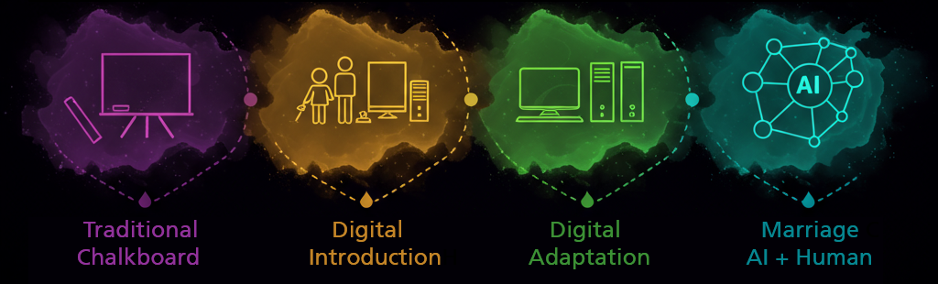
Progress is adaptability. The future isn’t waiting.
Beth Rudden
Past the Hype – It’s Here To Stay
Socrate’s Personal Ghostwriter
The Human Edge: Where Expertise Meets the Algorithm
Transformed Teacher Role
Notes:
Quote: WHY THIS MATTERS
Quote, Past Hype, Socrates no fan written word – Plato , Employer Needs, Tracher Teacher ( not all in H.Ed would agree)
consider they can learn facts anywhere anytime – evolution of H. Ed instruction?
Employers: incorporate expertise into scenarios -raise bar by evaluating AI thru critical thinking, effective communication of in person / online, and collaboration
Teach students to Human – New superpowers are ability to communicate and manage processes or others

Slide 3

AI As New Infrastructure
Shift from Novelty to New Foundation
Emphasis: AI supports, not replaces educators or humans
Key Message: Educators facilitate through adapting and guiding
Be Transparent
  If you use it, they should be able to as well
  Focus on ethical, responsible use
Notes:
Bullets – why
AI can do your job shortly –
- New Canvas can build assignment, workflow, rubrics and experiential assessments, then embed them into Canvas – add name of product here
- PLO discussions surround alignment and experiential learning as where deepest learning is and easiest way to show mastery that AI can’t do for them
- I ask them “what assessment do you most remember from K-12 or Higher Ed – let’s answer that
- Why?
- IDs instructors with creative skills rise to top
- Comment next to me – I can teach the content, the ID I appreciate shows me innovative ways to input experiential assessments into the course
- We IDs are their instructors, they just don’t know it yet.

Slide 4

Intentional Use
It’s Not About Whether, but rather how and why
  Career Use
  Ethics
  Transparency
AI Tools Supporting Pedagogical / Skills Learning
  Understand the tool
  Apply their knowledge to the response
  Analyze the response
  Evaluate against your knowledge and dig deeper
  Add your human element to further enhance what you’re working on
Notes:
Because they’ll need it in their careers
Teach them to use ethically, to foster deeper learning something they are interested in or need to know

Slide 5
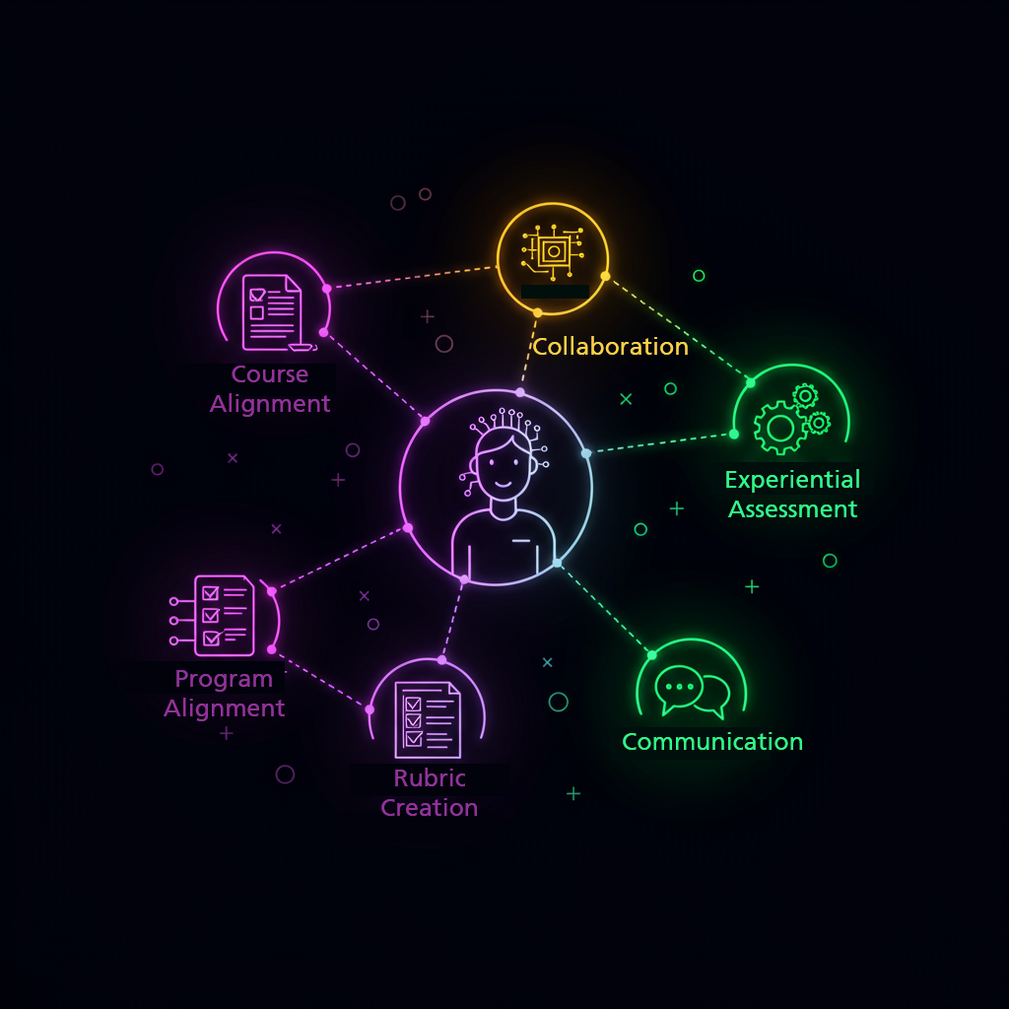
Teaching With AI
Support from LMMs
  Querry for alignment
  I am an expert at “x”, teaching “x”, key concepts for an 8-module course are “x”. Suggest CLOs that scaffold to learning at Bloom’s cognitive level 5
  Please add ideas for each module for student activities (ungraded) and formative assessment
Document Guidance
  Upload documents
  Ask AI to consolidate learning material and suggest
    Additional content, aligned activities, assessments, rubrics
  Create rubrics
  Upload a PDF and ask it to cite it for you in APA7
Notes:
Bullets – why
AI can do your job shortly –
- New Canvas can build assignment, workflow, rubrics and experiential assessments, then embed them into Canvas – add name of product here
- PLO discussions surround alignment and experiential learning as where deepest learning is and easiest way to show mastery that AI can’t do for them
- I ask them “what assessment do you most remember from K-12 or Higher Ed – let’s answer that
- Why?
- IDs instructors with creative skills rise to top
- Comment next to me – I can teach the content, the ID I appreciate shows me innovative ways to input experiential assessments into the course
- We IDs are their instructors, they just don’t know it yet.

Slide 6

Teaching With AI
LMM Guidance
  Can be launching pad to creation of rubrics, feedback, alignment quizzes
    Teachers request assignment ideas (experiential, project, group) and rubrics aligned with course CLOs
  Upload Learning Material and request ideas
  Define AI’s voice, role, goals
  Upload student assignments and request feedback from the AI as a starting point, iterate
    Similar process to assigning students to use and critically evaluate
Notes:
Bullets – why
AI can do your job shortly –
- New Canvas can build assignment, workflow, rubrics and experiential assessments, then embed them into Canvas – add name of product here
- PLO discussions surround alignment and experiential learning as where deepest learning is and easiest way to show mastery that AI can’t do for them
- I ask them “what assessment do you most remember from K-12 or Higher Ed – let’s answer that
- Why?
- IDs instructors with creative skills rise to top
- Comment next to me – I can teach the content, the ID I appreciate shows me innovative ways to input experiential assessments into the course
- We IDs are their instructors, they just don’t know it yet.

Slide 7

Student Use Of AI
Outlines, Storylines, Titles & More….
Build your own AI assistant, then use it in class
Go use AI, reflect, resolve. Send me your initial and follow up prompts
Notes:
Strategies Instructors Presented
Use AI to gather into, fact check with the knowledge they have gained, and use AI to create a presentation
I need a cool storyline for this presentation
I need a great title for this slide
Students build their own AI assisstants using Learning Material Presented, then use them for projects and quizzes
Students are asked to pose questions to the AI, they then reflect upon validity, fact check, and continue the conversation with AI
Vacation plans and mapping for a pdf or step by step on Google maps (wrong)
Six fingers and a missing leg

Slide 8

AI For Student Support
Instructor built 24/7 chat bot assistant
Eye tracking as student absorption feedback
Seeing engagement to empower early intervention
Notes:
Strategies Instructors Presented
Use AI to gather into, fact check with the knowledge they have gained, and use AI to create a presentation
I need a cool storyline for this presentation
I need a great title for this slide
Students build their own AI assisstants using Learning Material Presented, then use them for projects and quizzes
Students are asked to pose questions to the AI, they then reflect upon validity, fact check, and continue the conversation with AI
Vacation plans and mapping for a pdf or step by step on Google maps (wrong)
Six fingers and a missing leg

Slide 9

Fireside Chat: From Hype to Impact
Key Takeaway: Collaborate vs. Competing
Teach Students To:
  Use LLMs as thought partners
  Use critical thinking to refine AI output
  Design context aware prompts
Weave In Employer Focused Human Skills
  Critical Thinking
  Communication
  Collaboration
  Leadership
Teach Students to Human
Notes:
Baratunde Thurston’s message: Keep humanity at the center
Teach Students to Human by
Use AI to gather into, fact check with the knowledge they have gained, and use AI to create a presentation
I need a cool storyline for this presentation
I need a great title for this slide
Students build their own AI assisstants using Learning Material Presented, then use them for projects and quizzes
Students are asked to pose questions to the AI, they then reflect upon validity, fact check, and continue the conversation with AI
Vacation plans and mapping for a pdf or step by step on Google maps (wrong)
Six fingers and a missing leg

Slide 10

Concerns
Equity: Free vs Paid
Control of Access: Which LLM?
  Employers may restrict which tool is used
  Should educators? Would you know?
Encouragement: Evidence-based AI Procurement
  Exposure and opportunity for use in an ethical way
  What is ethical?
Notes:
Students introduced in earlier courses have a leg up on others not yet introduced in future courses

